Slide 1
Communicating Using I2C, SPI and UART
Inter-Integrated Circuit
Serial Peripheral Interface
Universal Asynchronous Receiver-Transmitter

Slide 2
Introduction
The I2C (Inter-Integrated Circuit) and SPI (Serial Peripheral Interface) standards were created to provide simple ways for digital information to be transferred between sensors and microcontrollers such as Arduino.
Arduino libraries for both I2C and SPI make it easy for you to use both of these protocols.
The choice between I2C and SPI is usually determined by the devices (for example, sensors, actuators, other boards) you want to connect.
Some devices provide both standards, but usually a device or chip supports one or the other.

Slide 3
Introduction
I2C VS SPI:
I2C is half duplex communication and SPI is full duplex communication as it has seperate inpput and output connections. .’. can receive and send at the same time.
I2C supports multi master and multi slave and SPI supports single master and multi slave.
I2C is a two wire protocol(only 2 signal connections for CLOCK(SCL) & DATA(SDA)) and SPI is a four wire protocol(CLOCK(SCLK), INPUT & OUTPUT(MISO, MOSI), SELECT ACTIVE DEVICE(SS/CS)).
SPI is faster than I2C.
I2C needs more complicated hardware to implement than SPI
I2C has the advantage that it only needs two signal connections (clock and data) to Arduino, while SPI needs four.
With I2C, you also get acknowledgment that signals have been correctly received.
The disadvantages are that the data rate is slower than SPI and data can only be traveling in one direction at a time, lowering the data rate even more if two-way communication is needed.
It is also necessary to connect pullup resistors to the connections to ensure reliable transmission of signals

Slide 4
Introduction
The advantages of SPI are that it runs at a higher data rate, and it has separate input and output connections, so it can send and receive at the same time.
It uses one additional line per device to select the active device.
It also uses a signal connection for a clock signal, so SPI requires four signal connections in all.

Slide 5
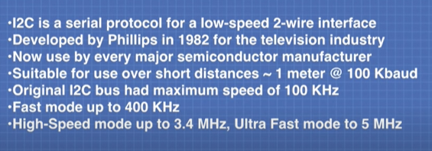
I2C Bus Communications

Slide 6
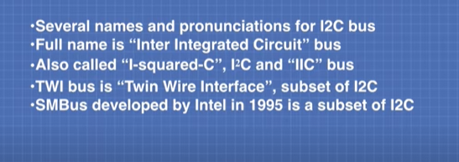
I2C Bus Communications

Slide 7
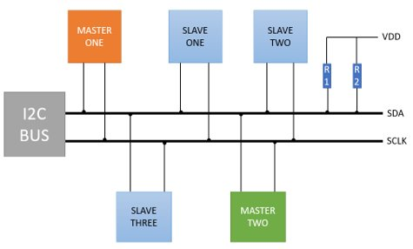
I2C Bus Communications

Slide 8
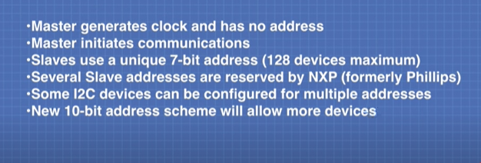
I2C Bus Communications

Slide 9
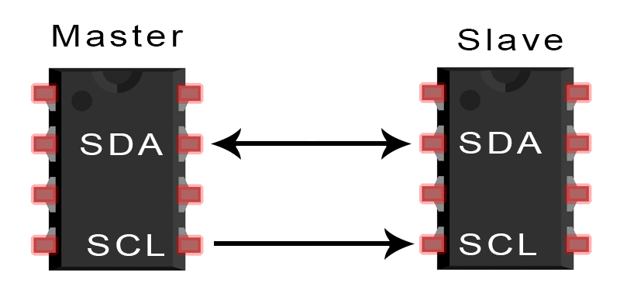
I2C Communication Protocol
SDA (Serial Data) – The line for the master and slave to send and receive data.
SCL (Serial Clock) – The line that carries the clock signal.

Slide 10
I2C Communication Protocol
With I2C, you can connect multiple slaves to a single master and you can have multiple masters controlling single, or multiple slaves.
This is really useful when you want to have more than one microcontroller logging data to a single memory card or displaying text to a single LCD.
I2C is a serial communication protocol, so data is transferred bit by bit along a single wire (the SDA line).
I2C is synchronous, so the output of bits is synchronized to the sampling of bits by a clock signal shared between the master and the slave. The clock signal is always controlled by the master.

Slide 11
I2C Communication Protocol
I2C supported frequencies
Standard mode: I2C in this mode goes up to the speed of 100 kilobits per second.
Fast mode: The maximum speed is 400 kilobits per second for this mode.

Slide 12
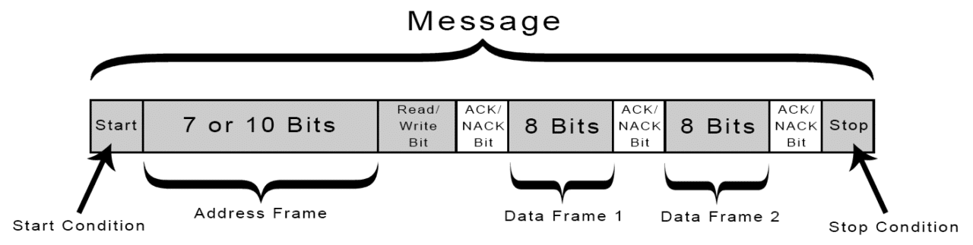
HOW I2C WORKS
With I2C, data is transferred in messages.
Messages are broken up into frames of data.
Each message has an address frame that contains the binary address of the slave and one or more data frames that contain the data being transmitted.
The message also includes start and stop conditions, read/write bits, and ACK/NACK bits between each data frame:

Slide 13
HOW I2C WORKS
Start Condition: The SDA line switches from a high voltage level to a low voltage level before the SCL line switches from high to low.
Stop Condition: The SDA line switches from a low voltage level to a high voltage level after the SCL line switches from low to high.
Address Frame: A 7 or 10 bit sequence unique to each slave that identifies the slave when the master wants to talk to it.

Slide 14
HOW I2C WORKS
Read/Write Bit: A single bit specifying whether the master is sending data to the slave (low voltage level) or requesting data from it (high voltage level).
ACK/NACK Bit: Each frame in a message is followed by an acknowledge/no-acknowledge bit. If an address frame or data frame was successfully received, an ACK bit is returned to the sender from the receiving device.

Slide 15
ADDRESSING:
I2C doesn’t have slave select lines, so it needs another way to let the slave know that data is being sent to it, and not another slave.
It does this by addressing. The address frame is always the first frame after the start bit in a new message.
The master sends the address of the slave it wants to communicate with to every slave connected to it.
Each slave then compares the address sent from the master to its own address.
If the address matches, it sends a low voltage ACK bit back to the master.
If the address doesn’t match, the slave does nothing and the SDA line remains high.

Slide 16
READ/WRITE BIT
The address frame includes a single bit at the end that informs the slave whether the master wants to write data to it or receive data from it.
If the master wants to send data to the slave, the read/write bit is a low voltage level.
If the master is requesting data from the slave, the bit is a high voltage level.

Slide 17
THE DATA FRAME
After the master detects the ACK bit from the slave, the first data frame is ready to be sent.
The data frame is always 8 bits long, and sent with the most significant bit first.
Each data frame is immediately followed by an ACK/NACK bit to verify that the frame has been received successfully.
The ACK bit must be received by either the master or the slave (depending on who is sending the data) before the next data frame can be sent.
After all of the data frames have been sent, the master can send a stop condition to the slave to halt the transmission.
The stop condition is a voltage transition from low to high on the SDA line after a low to high transition on the SCL line, with the SCL line remaining high.

Slide 18
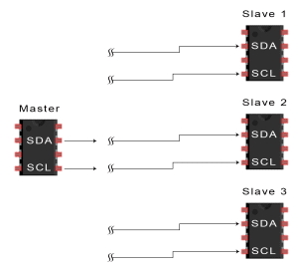
STEPS OF I2C DATA TRANSMISSION
1. The master sends the start condition to every connected slave by switching the SDA line from a high voltage level to a low voltage level before switching the SCL line from high to low:
SDA switched from H->L before SCL switched from H->L (from right to left)

Slide 19
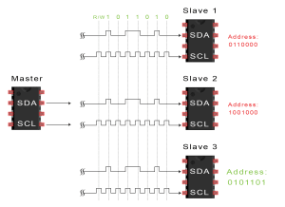
2. The master sends each slave the 7 or 10 bit address of the slave it wants to communicate with, along with the read/write bit:
master wanted to communicate with slave 3
if master wanted to R -> high
................................w -> low

Slide 20
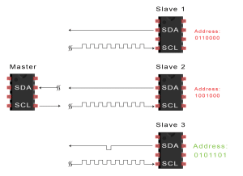
3. Each slave compares the address sent from the master to its own address. If the address matches, the slave returns an ACK bit by pulling the SDA line low for one bit. If the address from the master does not match the slave’s own address, the slave leaves the SDA line high.
master wanted to communicate with slave 3
ACK=> low
NACK=> no change, slaves leaves the SDA line high
ACK

Slide 21
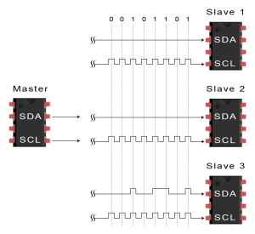
The master sends or receives the data frame:
master wanted to send data = 10110100 to slave 3
MSB sent 1st
MSB

Slide 22
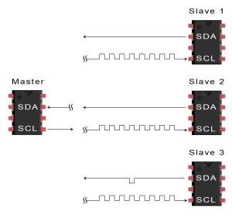
After each data frame has been transferred, the receiving device returns another ACK bit to the sender to acknowledge successful receipt of the frame:
ACK

Slide 23
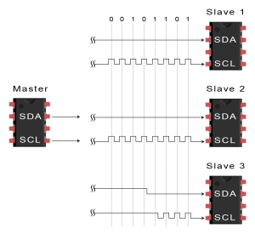
To stop the data transmission, the master sends a stop condition to the slave by switching SCL high before switching SDA high:
SCLswitched from L->H before SDA switched from L->H(from right to left)

Slide 24
SINGLE MASTER WITH MULTIPLE SLAVES
Because I2C uses addressing, multiple slaves can be controlled from a single master.
With a 7 bit address, 128 (2⁷) unique address are available. Using 10 bit addresses is uncommon, but provides 1,024 (2¹⁰) unique addresses.
To connect multiple slaves to a single master, wire them like this, with 4.7K Ohm pull-up resistors connecting the SDA and SCL lines to Vcc:

Slide 25
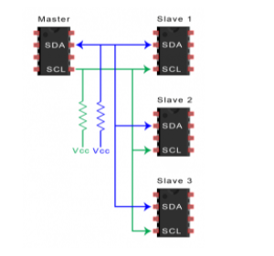

Slide 26
MULTIPLE MASTERS WITH MULTIPLE SLAVES
Multiple masters can be connected to a single slave or multiple slaves.
The problem with multiple masters in the same system comes when two masters try to send or receive data at the same time over the SDA line.
To solve this problem, each master needs to detect if the SDA line is low or high before transmitting a message.
If the SDA line is low, this means that another master has control of the bus, and the master should wait to send the message.
If the SDA line is high, then it’s safe to transmit the message.
To connect multiple masters to multiple slaves, use the following diagram, with 4.7K Ohm pull-up resistors connecting the SDA and SCL lines to Vcc:

Slide 27
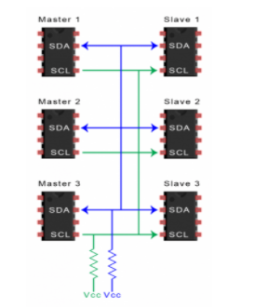

Slide 28
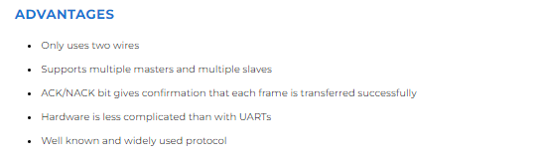
ADVANTAGES AND DISADVANTAGES OF I2C

Slide 29
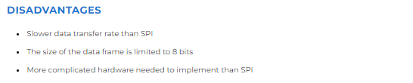
ADVANTAGES AND DISADVANTAGES OF I2C

Slide 30
HOW TO USE SPI COMMUNICATION ON THE ARDUINO
SPI is an acronym for Serial Peripheral Interface.
SPI is a type of synchronous serial communication, which means that data transfer is timed with clock pulses.
SPI communication isn’t good for transmitting data over long distances.
It should only be used for communication between devices that are less than 10 meters apart.
An SPI network consists of a master device and one or more slave devices connected on a bus.

Slide 31
HOW TO USE SPI COMMUNICATION ON THE ARDUINO
SPI MASTER DEVICE
The master device sends data to, and receives data from slave devices. There is only one master device in an SPI network.
SPI SLAVE DEVICE
The slave device receives commands from the master device, and sends data back to the master device. There can be one or more slave devices in an SPI network.

Slide 32
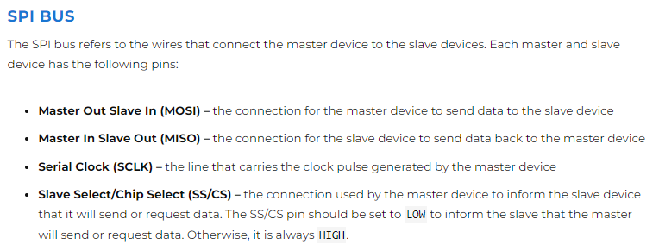

Slide 33
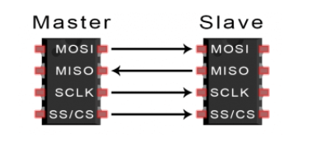
CONNECTING A MASTER DEVICE TO A SINGLE SLAVE DEVICE
If there is only one slave device in the network, connecting it to the master device is pretty straightforward.
The slave device’s pins are connected to the same pins on the master device.

Slide 34
SENDING DATA TO A SINGLE SLAVE DEVICE
To send data from the master device to the slave device, you first need to set the SS/CS pin on the master device to LOW, and keep it LOW for the duration of the data exchange.
This prepares the slave device to send or receive data.
Once the SS/CS pin is LOW, the master can send data over the MOSI line and simultaneously produce clock pulses from the SCLK pin.

Slide 35
CONNECTING A MASTER DEVICE TO MULTIPLE SLAVE DEVICES
For an SPI network with multiple slave devices, there are two options for wiring – the independent slave configuration and the daisy chain configuration.
INDEPENDENT SLAVE CONFIGURATION
The master device has multiple SS/CS pins. Each SS/CS pin connects to a separate slave device:

Slide 36
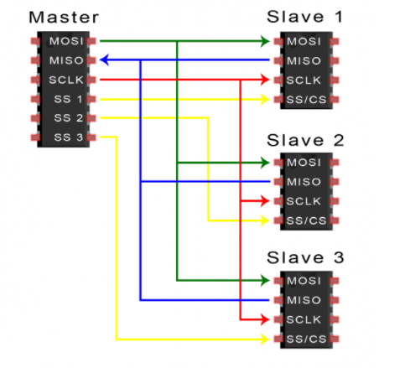

Slide 37
SENDING DATA IN AN INDEPENDENT SLAVE CONFIGURATION
When the master device needs to communicate with a particular slave device, it pulls the SS/CS pin of the slave device LOW.
This informs the slave device that the master will send data to it. The master device keeps the SS/CS pin LOW for the duration of the data exchange between the devices.
After the SS/CS pin is set to LOW, the master sends the data over the MOSI line.
At the same time, it also sends clock pulses over the SCLK line.
If the master device expects a response from the slave device, it will continue to send clock pulses until the data is received at the MISO pin.

Slide 38
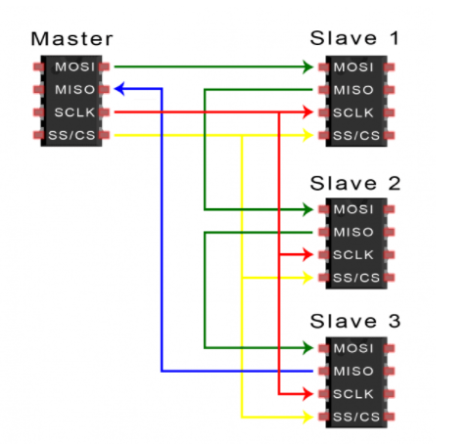
DAISY CHAIN CONFIGURATION
In the daisy chain configuration, the master device only needs one SS/CS pin to communicate with all of the slave devices.

Slide 39
SENDING DATA IN A DAISY CHAIN CONFIGURATION
In the daisy chain configuration, the master device first pulls the SS/CS pin LOW to initiate communication.
This will signal all of the slave devices to prepare to receive data at their MOSI pins.
The master device then sends data over its MOSI pin to the first slave device in the chain.
At the same time, it generates clock pulses at the SCLK pin.
The data sent from the master then flows from one slave to the next in the chain.

Slide 40
SENDING DATA IN A DAISY CHAIN CONFIGURATION
Similar to the other SPI network configurations, the SS/CS pins are kept LOW for the duration of data transmission.
The master needs to send enough clock pulses for the data to reach the last slave device in the chain.
If a response from a slave device is expected, the master device will continue to send clock pulses until all of the response data is received at its MISO pin.

Slide 41
HOW SPI WORKS
THE CLOCK
The clock signal synchronizes the output of data bits from the master to the sampling of bits by the slave.
One bit of data is transferred in each clock cycle, so the speed of data transfer is determined by the frequency of the clock signal.
SPI communication is always initiated by the master since the master configures and generates the clock signal.
Any communication protocol where devices share a clock signal is known as synchronous.
SPI is a synchronous communication protocol.

Slide 42
HOW SPI WORKS
The clock signal in SPI can be modified using the properties of clock polarity and clock phase.
These two properties work together to define when the bits are output and when they are sampled.
Clock polarity can be set by the master to allow for bits to be output and sampled on either the rising or falling edge of the clock cycle.
Clock phase can be set for output and sampling to occur on either the first edge or second edge of the clock cycle, regardless of whether it is rising or falling.

Slide 43
MOSI AND MISO
The master sends data to the slave bit by bit, in serial through the MOSI line. The slave receives the data sent from the master at the MOSI pin. Data sent from the master to the slave is usually sent with the most significant bit first.
The slave can also send data back to the master through the MISO line in serial. The data sent from the slave back to the master is usually sent with the least significant bit first.

Slide 44
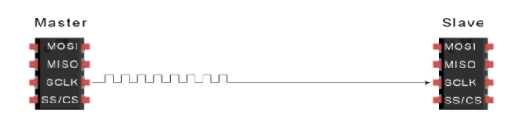
STEPS OF SPI DATA TRANSMISSION
1. The master outputs the clock signal:

Slide 45
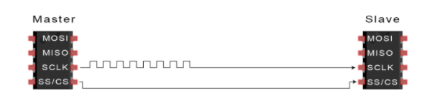
STEPS OF SPI DATA TRANSMISSION
2. The master switches the SS/CS pin to a low voltage state, which activates the slave.

Slide 46
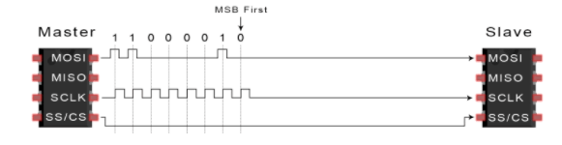
STEPS OF SPI DATA TRANSMISSION
3. The master sends the data one bit at a time to the slave along the MOSI line. The slave reads the bits as they are received:

Slide 47
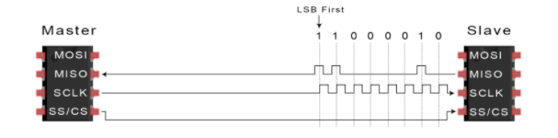
STEPS OF SPI DATA TRANSMISSION
4. If a response is needed, the slave returns data one bit at a time to the master along the MISO line. The master reads the bits as they are received.

Slide 48
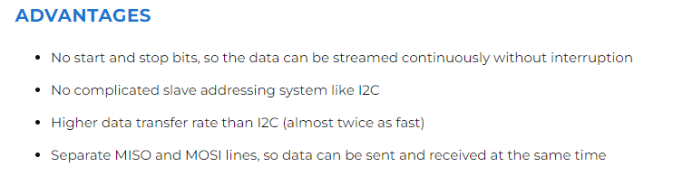
ADVANTAGES AND DISADVANTAGES OF SPI

Slide 49
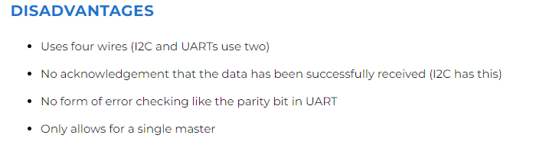
ADVANTAGES AND DISADVANTAGES OF SPI

Slide 50
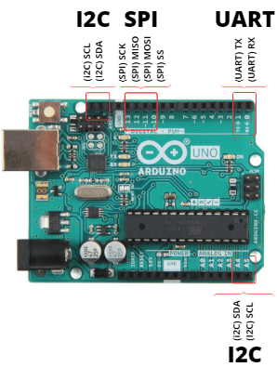
UART Communication Protocol

Slide 51
UART
UART, or universal asynchronous receiver-transmitter, is one of the most used device-to-device communication protocols.
By definition, UART is a hardware communication protocol that uses asynchronous serial communication with configurable speed.
Asynchronous means there is no clock signal to synchronize the output bits from the transmitting device going to the receiving end.

Slide 52
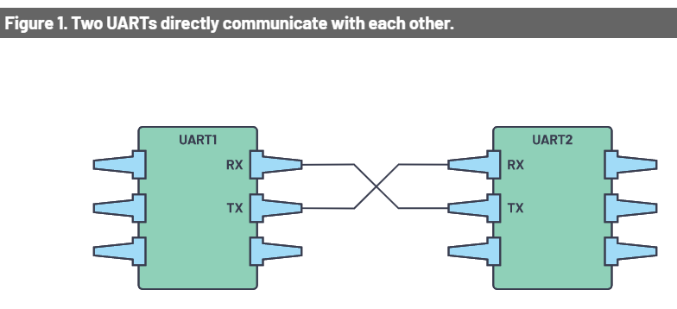
UART

Slide 53
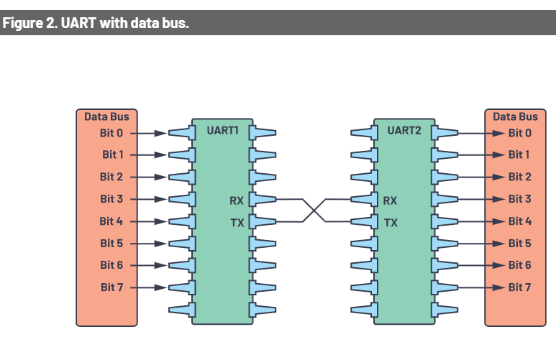
UART
The two signals of each UART device are named:
Transmitter (Tx)
Receiver (Rx)
The main purpose of a transmitter and receiver line for each device is to transmit and receive serial data intended for serial communication.

Slide 54
UART
The transmitting UART is connected to a controlling data bus that sends data in a parallel form.
From this, the data will now be transmitted on the transmission line (wire) serially, bit by bit, to the receiving UART.
This, in turn, will convert the serial data into parallel for the receiving device.
For UART and most serial communications, the baud rate needs to be set the same on both the transmitting and receiving device.
In the serial port context, the set baud rate will serve as the maximum number of bits per second to be transferred.

Slide 55
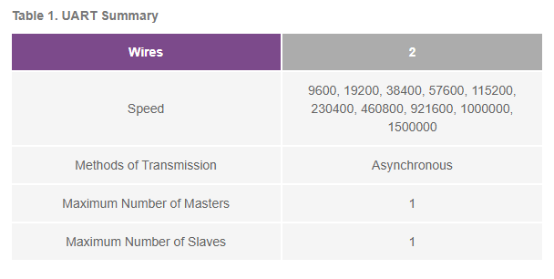
UART

Slide 56
UART
The UART interface does not use a clock signal to synchronize the transmitter and receiver devices; it transmits data asynchronously.
Instead of a clock signal, the transmitter generates a bitstream based on its clock signal while the receiver is using its internal clock signal to sample the incoming data.
The point of synchronization is managed by having the same baud rate on both devices.

Slide 57
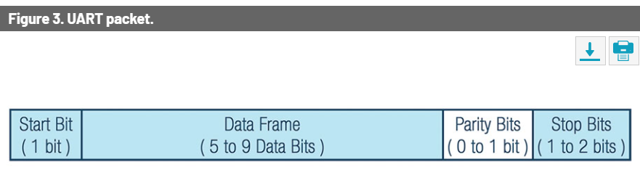
UART
Data Transmission
In UART, the mode of transmission is in the form of a packet.
A packet consists of a start bit, data frame, a parity bit, and stop bits.

Slide 58
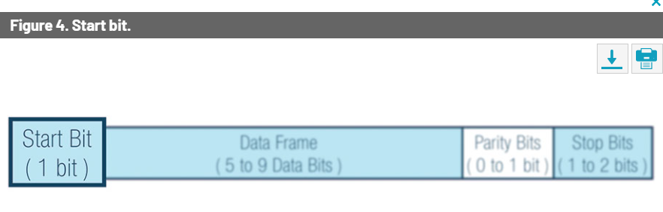
UART
Start Bit
The UART data transmission line is normally held at a high voltage level when it’s not transmitting data.
To start the transfer of data, the transmitting UART pulls the transmission line from high to low for one (1) clock cycle.
When the receiving UART detects the high to low voltage transition, it begins reading the bits in the data frame at the frequency of the baud rate.

Slide 59
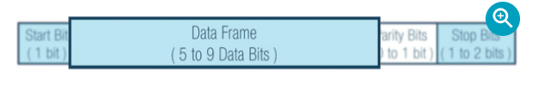
UART
Data Frame
The data frame contains the actual data being transferred.
It can be five (5) bits up to eight (8) bits long if a parity bit is used.
If no parity bit is used, the data frame can be nine (9) bits long.
In most cases, the data is sent with the least significant bit first.

Slide 60
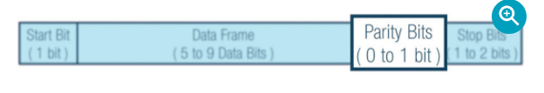
UART
Parity Bit
The parity bit is a way for the receiving UART to tell if any data has changed during transmission.
Bits can be changed by electromagnetic radiation, mismatched baud rates, or long-distance data transfers.

Slide 61
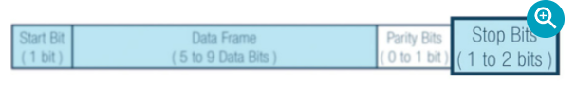
UART
Stop Bits
To signal the end of the data packet, the sending UART drives the data transmission line from a low voltage to a high voltage for one (1) to two (2) bit(s) duration.

Slide 62
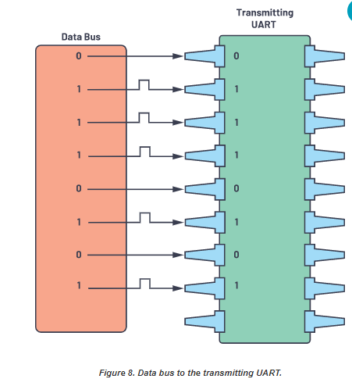
UART (Steps of UART Transmission)
First: The transmitting UART receives data in parallel from the data bus.

Slide 63
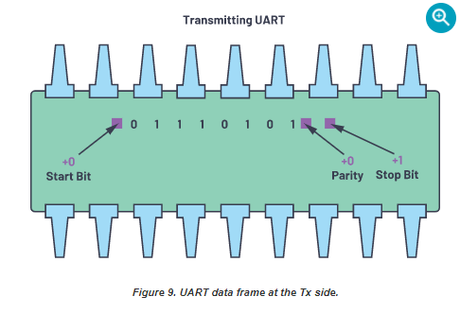
UART (Steps of UART Transmission)
Second: The transmitting UART adds the start bit, parity bit, and the stop bit(s) to the data frame.

Slide 64
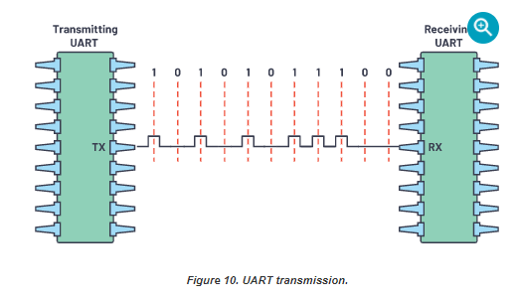
UART (Steps of UART Transmission)
Third: The entire packet is sent serially starting from start bit to stop bit from the transmitting UART to the receiving UART. The receiving UART samples the data line at the preconfigured baud rate.

Slide 65
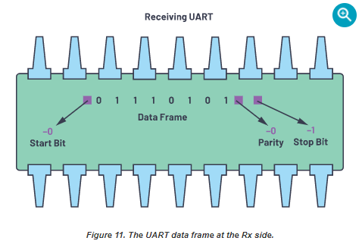
UART (Steps of UART Transmission)
Fourth: The receiving UART discards the start bit, parity bit, and stop bit from the data frame.

Slide 66
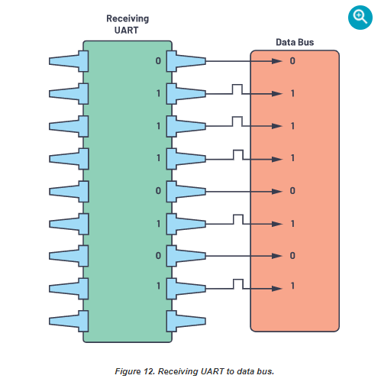
UART (Steps of UART Transmission)
Fifth: The receiving UART converts the serial data back into parallel and transfers it to the data bus on the receiving end.

Slide 67
UART (Frame Protocol)
The main use and importance of frame protocol is an added value for security and protection on each device.
When two devices use the same UART frame protocol, there are tendencies that, when connecting to the same UART without checking the configuration, the device will be connected to different pins that may cause malfunctions in the system.
In designing a frame protocol, designers can set the desired headers and trailers, including CRC, to different devices. In Figure 13, two (2) bytes are set as part of the header.

Slide 68
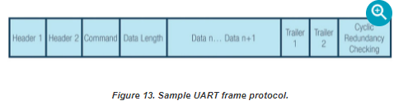
UART (Frame Protocol)

Slide 69
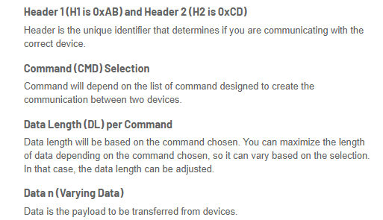
UART (Frame Protocol)

Slide 70
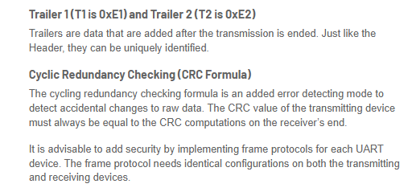
UART (Frame Protocol)

